Slide 1



what is config server?
What is mongos.exe?

Slide 2
Sharding Configuration

Slide 3
Setting up sharded mongodb cluster
A sharded setup of mongodb requires the following:
Mongodb Configuration server – this stores the cluster’s metadata
mongos instance – this is the router and routes the queries to different shards based on the sharding key
Individual mongodb instances(mongo) – these act as the shards.

Slide 4
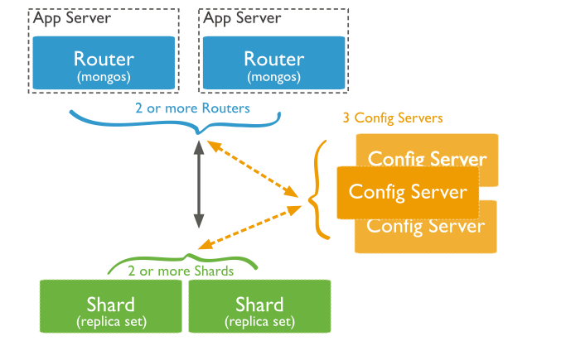

Architecture diagram
The below is the architecture diagram of a sample mongodb sharded setup:-

Slide 5
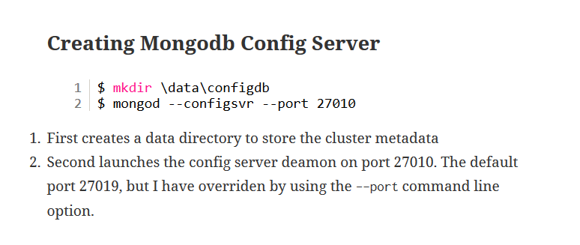

Slide 6
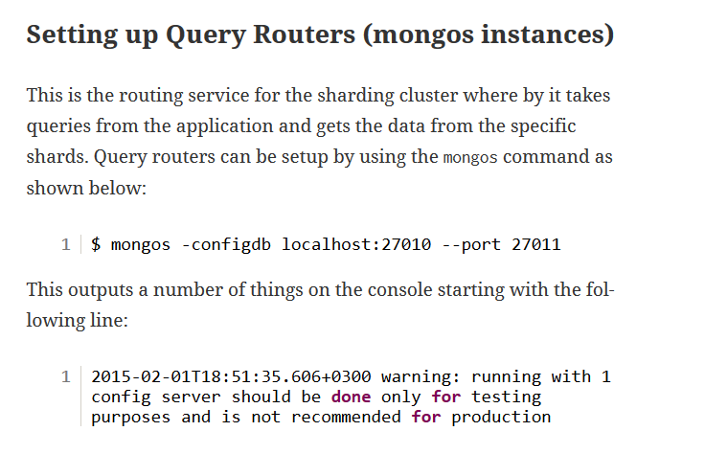

Slide 7
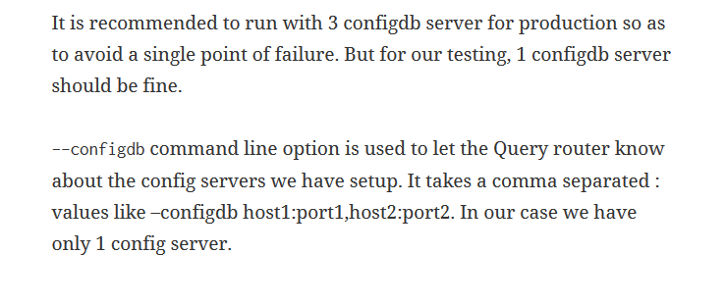

Slide 8
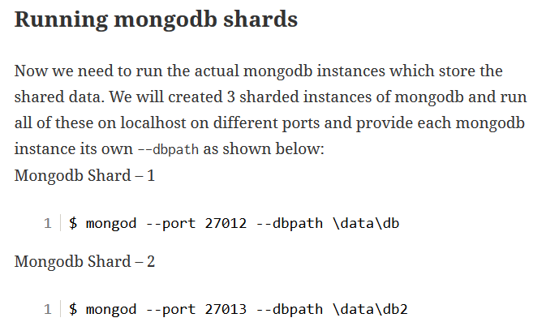

Slide 9
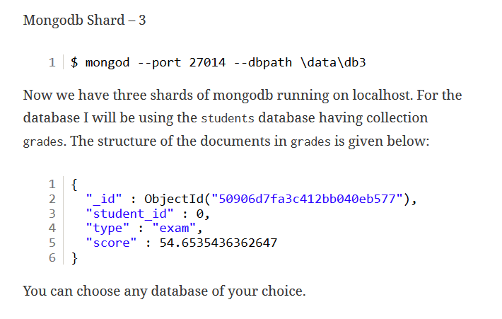

Slide 10
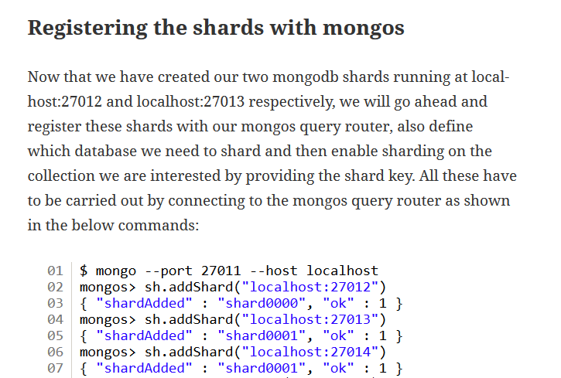

Slide 11
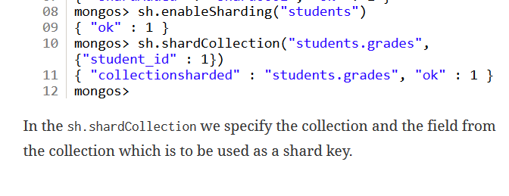

Slide 12
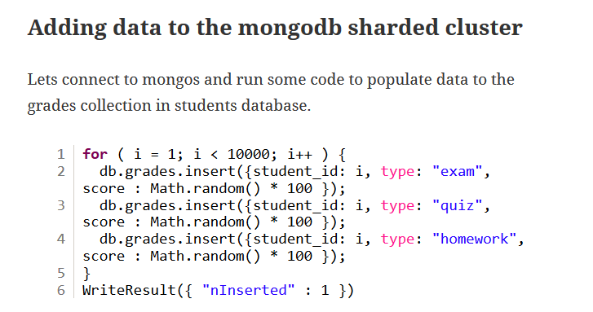
for ( i = 1; i < 10000; i++ ) { db.grades.insert({student_id: i, type: "exam", score : Math.random() * 100 });
db.grades.insert({student_id: i, type: "quiz", score : Math.random() * 100 });
db.grades.insert({student_id: i, type: "homework", score : Math.random() * 100 }); }

Slide 13
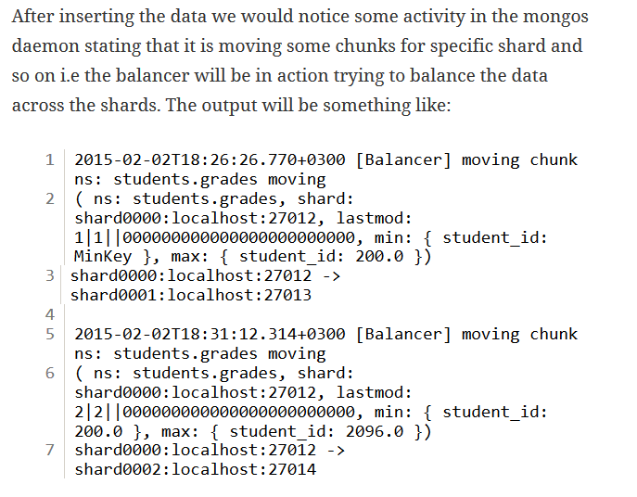

Slide 14
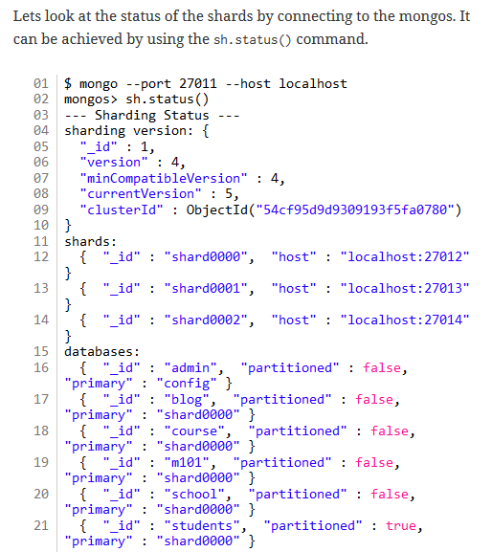

Slide 15
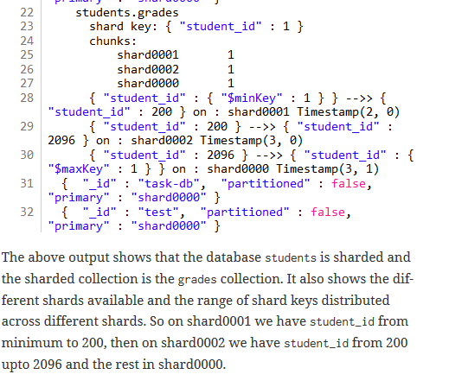

Slide 16
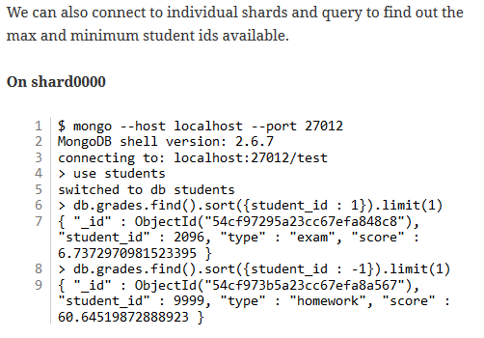

Slide 17
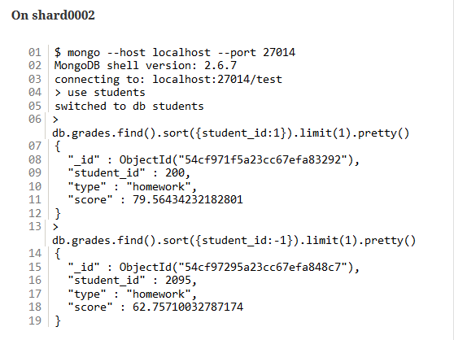

Slide 18

Configure the Sharding
Insert some records
Check the status

Slide 19
Thank you for your attention!

